Slide 1
CS584 Machine Learning
Lecture 1. Introduction into Machine Learning
Oleksandr Narykov
onarykov@iit.edu

Slide 2
Introduction
Instructor
Oleksandr Narykov (onarykov@iit.edu)
TA
Ruo Yang (ryang23@hawk.iit.edu)
Bandhavi Parvathaneni (bparvathaneni@hawk.iit.edu)
Reza Shahbazi (rshahbazimehrizi@hawk.iit.edu)
Office hours – TBD
Programming language: Python.
Libraries: scikit-learn, PyTorch
Notes:
Without assumptions you cannot make predictions
Declarative representations are different from the purely data-driven machine learning algorithms
They allow us to incorporate prior domain knowledge into generative model and separate it from

Slide 3
Course Description
http://bulletin.iit.edu/search/?search=cs+584
Introduce fundamental problems in machine learning
Provide understanding of techniques, mathematical concepts, and algorithms used in machine learning.
Provide understanding of the limitations of various machine learning algorithms and the way to evaluate performance of learning algorithms.
Topics include introduction, regression, kernel methods, generative learning, discriminative learning, neural networks, support vector machines, graphical models, unsupervised learning, and dimensionality reduction.
4

Slide 4
Topics
Concept learning
Evaluating models
Logistic regression
Regression
Decision trees
Naïve Bayes
Neural networks
SVMs
Clustering
MDPs
Reinforcement learning
Notes:
Without assumptions you cannot make predictions
Declarative representations are different from the purely data-driven machine learning algorithms
They allow us to incorporate prior domain knowledge into generative model and separate it from

Slide 5
Textbook
There is no required textbook for the course
Recommended literature
Christopher M. Bishop, Pattern Recognition and Machine Learning
http://www.cs.cmu.edu/~tom/mlbook.html
Selected chapters from Information Theory, Inference, and Learning Algorithms by D. MacKay
6

Slide 6
What This Course is and What it isn’t
This is not a deep learning course
We’ll cover DL but not in depth
This is not a reinforcement learning course
We’ll cover RL but not in depth
This is not about big data
We’ll use datasets that can be processed using
personal computers
This is an overview course; we’ll cover both
Theory (optimization for example)
Applications (Python programming using small datasets)
7

Slide 7
Course Objectives and Outcomes
Understand the why and how of ML
Derive fundamental algorithms starting from basic mathematical and probabilistic principles
Apply several algorithms to real-world datasets
Perform model and hyperparameter selection
Elaborate the limitations of ML models
9

Slide 8
GRADING
Assignments | 40%
Project | 30%
Midterm Exam | 15%
Final Exam | 15%
13

Slide 9
Assignments (40%)
5 – 7 assignments
Most assignments will have two parts
Written
Programming
Possible assignment topics
Decision trees
Naïve Bayes
Logistic regression
Regression
SVMs
Neural networks
Clustering
Reinforcement learning
14

Slide 10
Project (30%)
One-month long project
Will consist of
Programming
A presentation document
A final report
Current idea (might change later)
Pick a reasonable size dataset
Conduct an analysis of several algorithms and hyperparameters using learning curves and several performance metrics
15

Slide 11
Late Submission Policy for Assignments
5-minute grace period, without any penalty
One hour late -5 points
One day late -7 points
Two days late -12 points
After two days no submissions accepted except for cases where permission was granted BEFORE the deadline, or due to exceptional circumstances
16

Slide 12
Exams
A midterm (15%) and a final (15%)
Like written assignments
Via Blackboard/Lumina
Midterm exam date
October; date TBD
Final exam date
December 5 – 10
The date is TBD by the university
17

Slide 13
Academic honesty
https://web.iit.edu/student-affairs/handbook/fine- print/code-academic-honesty
18

Slide 14
Accommodations
Reasonable accommodations will be made for students with documented disabilities. In order to receive accommodations, students must obtain a letter of accommodation from the Center for Disability Resources
https://www.iit.edu/cdr
19

Slide 15
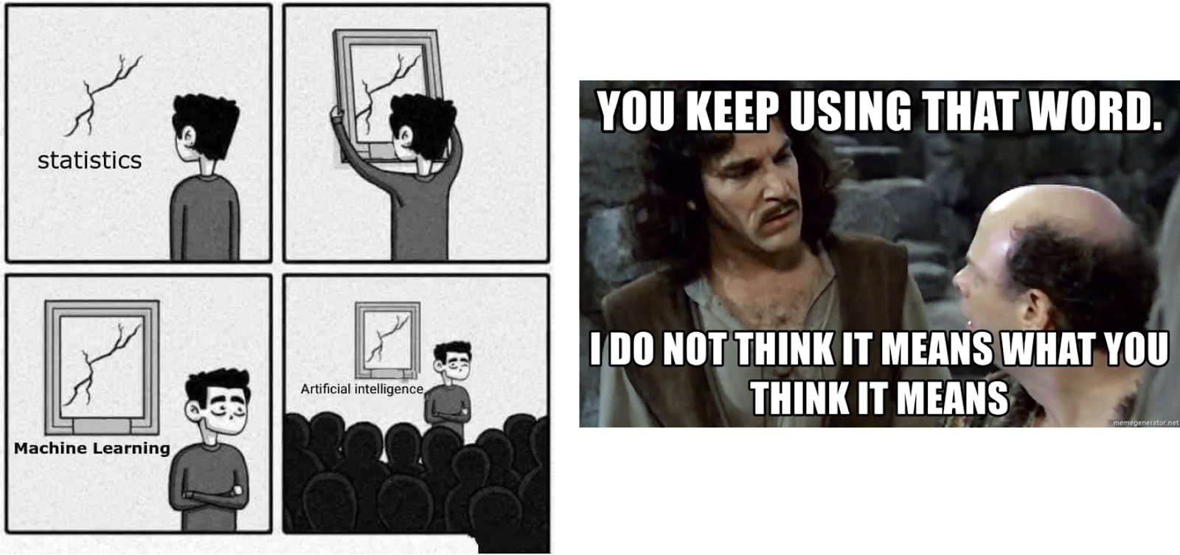
Machine Learning
Tests relationships between variables
Highly interpretable
Assesses uncertainty
Statistics
Learning patterns from data
Making predictions on new data
Many models are black box
Machine
Learning
Set of technic to enable machines to mimic human behavior
Machine Learning is a subset of AI
Artificial
Intelligence
4

Slide 16
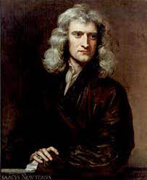
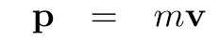
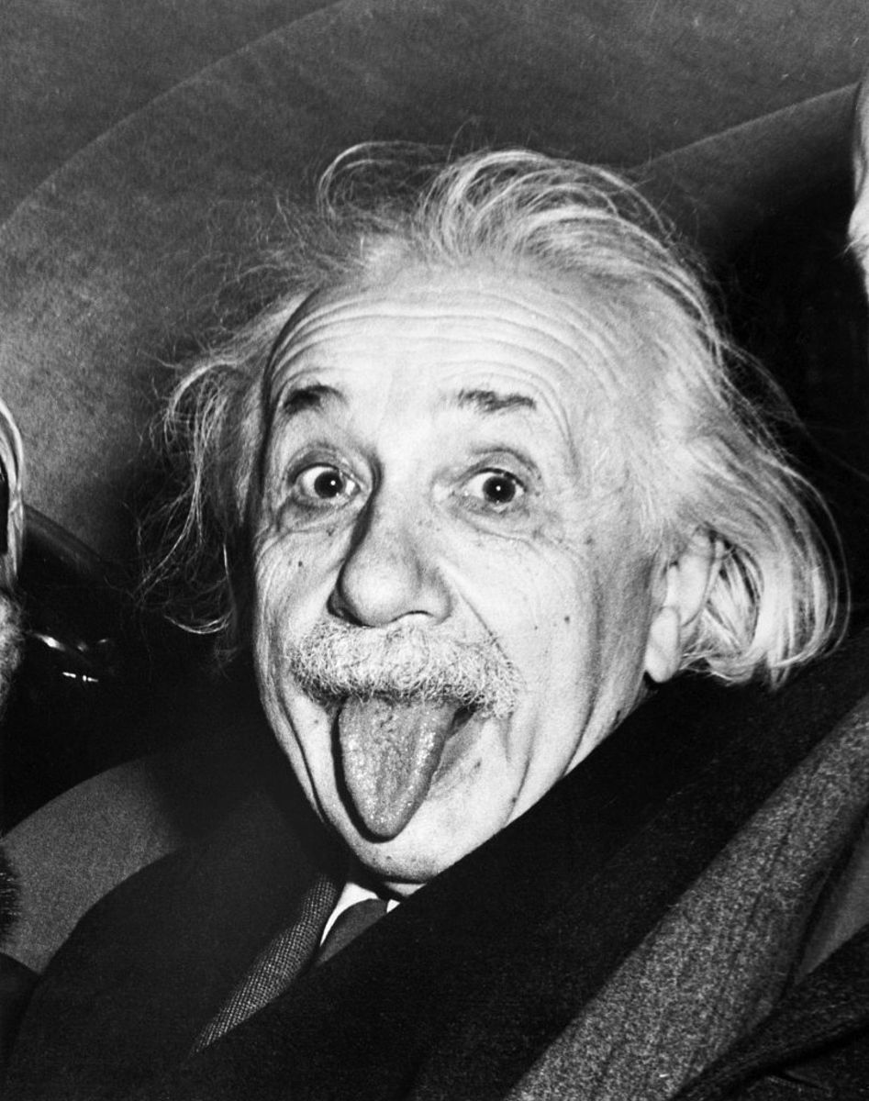
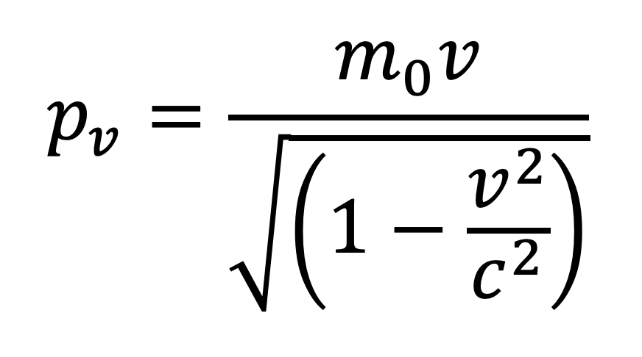
Modeling Data
“All models are wrong, but some are useful”
- George Box

Slide 17
Concept Learning
Induce a general function from specific training examples
Concept: spam; training examples: emails labeled as spam/~spam
Concept: heartDisease; training examples: patient records labeled as heartDisease/~heartDisease
Concept: positive; training examples: reviews labeled as positive/negative
…
Goal: induce a general function that fits to the training data well and generalizes well to unseen/future data
4

Slide 18
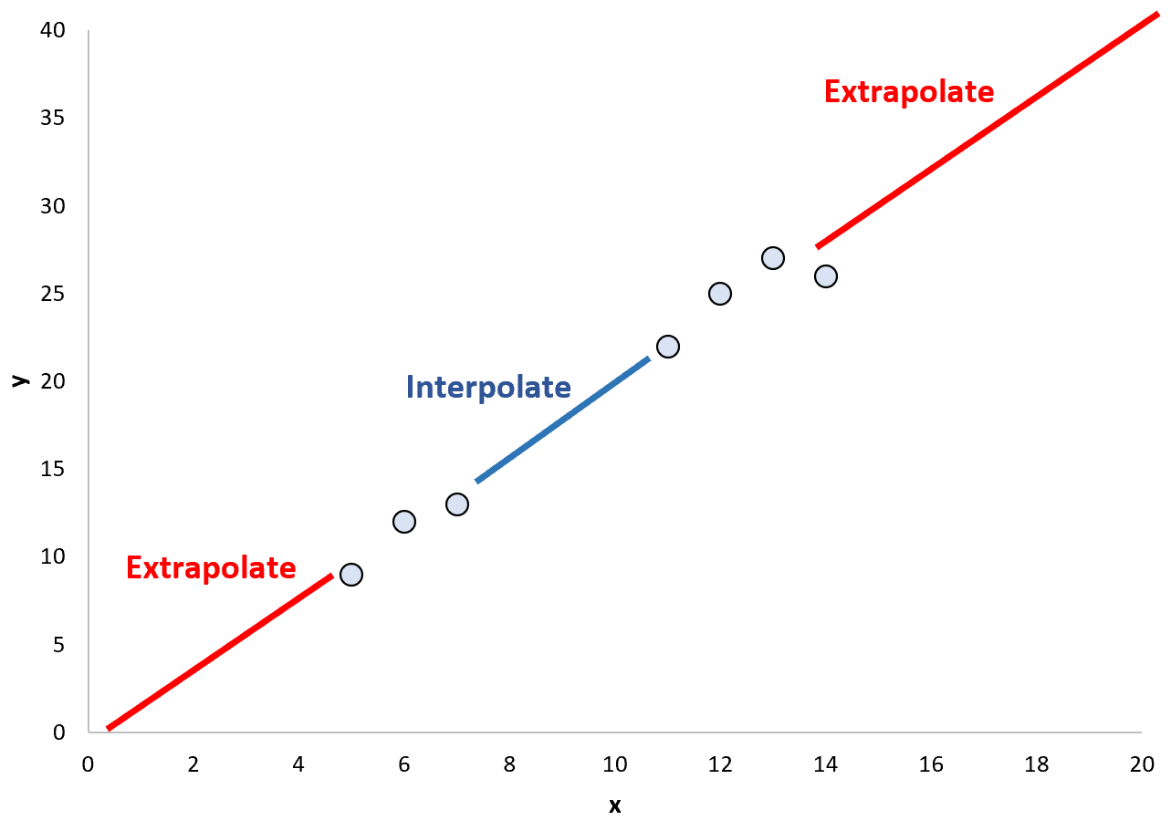
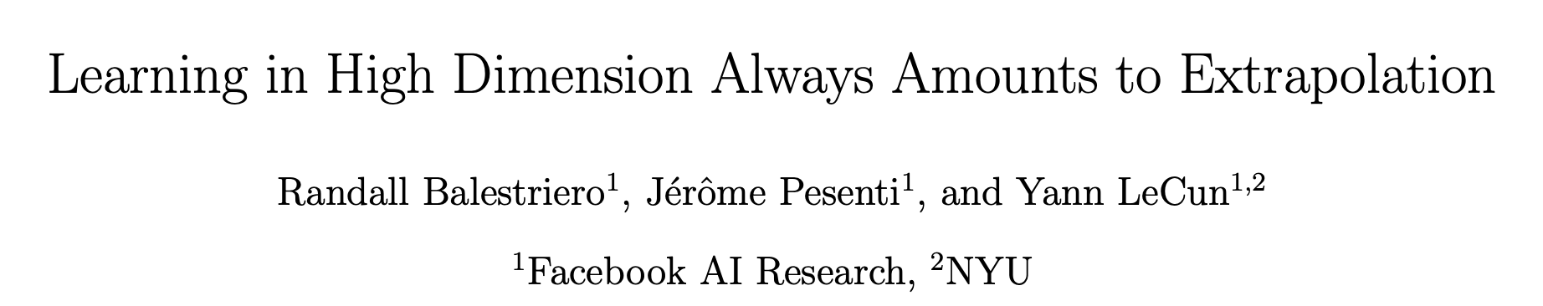
Possible Scenarios

Slide 19
Problem Formulation
Define a space of hypotheses / functions
Search for a hypothesis/function that fits well to the training data
To search efficiently, utilize the structure of the hypothesis space
In this chapter, we will utilize general-to-specific ordering of hypotheses
5

Slide 20
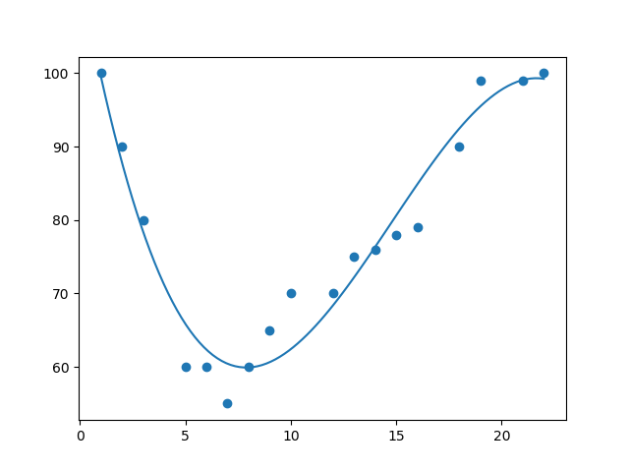
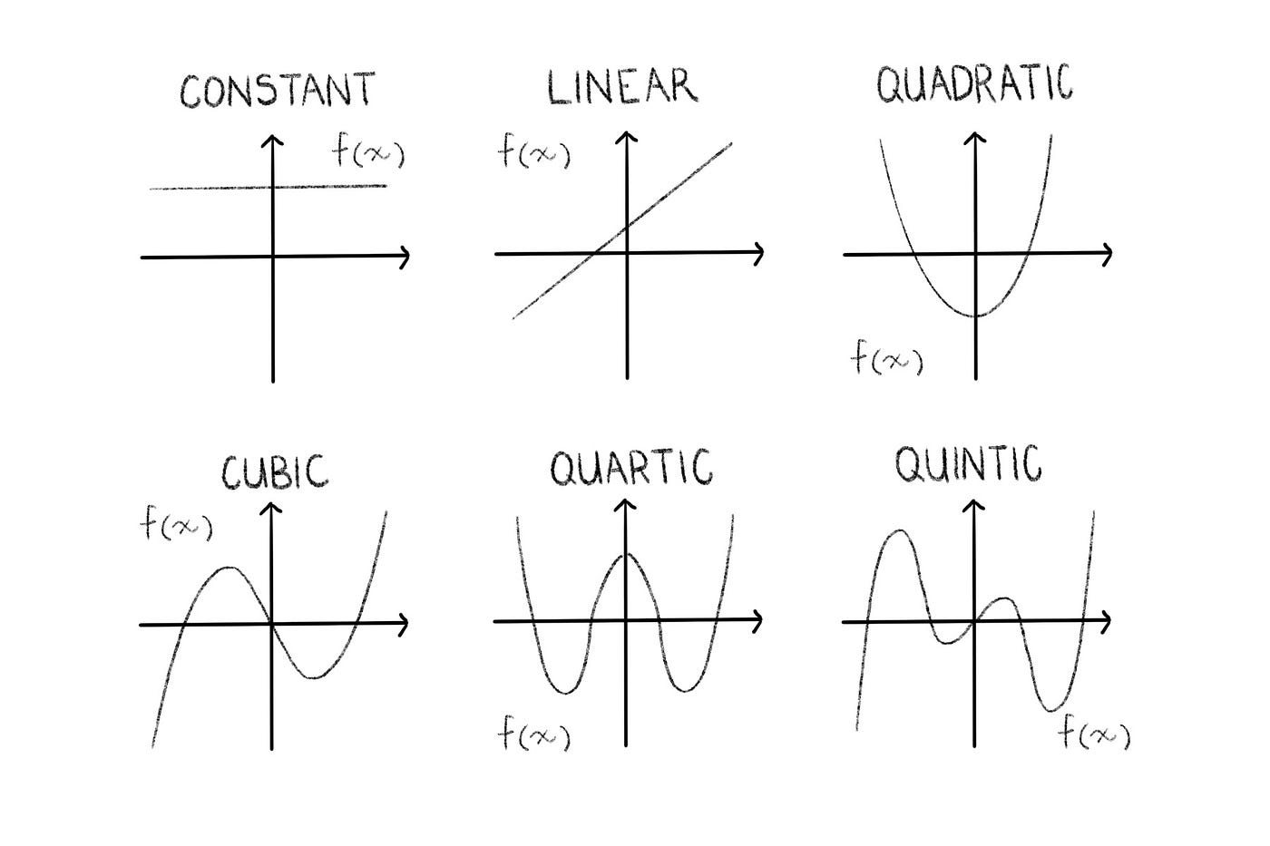
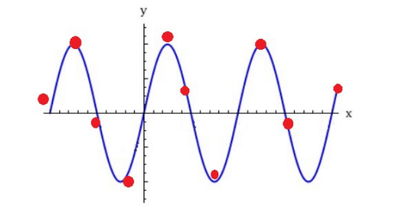
Data Space and Hypotheses
5

Slide 21
The Million-Dollar Question
What does the hypothesis even look like? What is the hypothesis space?
Is it
a logical formula of conjunctions (ANDs) and disjunctions (ORs)?
a set of rules?
a decision tree?
a linear additive function where each feature has its own weight, and it contributes one way or the other?
a non-linear function?
7

Slide 22
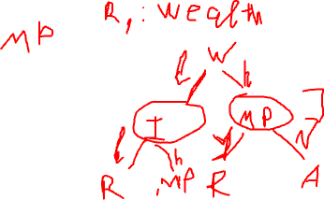
Simple Exercise
You are training a model for loan approval/rejection. Inputs are: MissedPayments, Income, Wealth. The output is the decision to approve or reject the loan application. Here is a training dataset.
MissedPayments | Income | Wealth | Decision
Yes | Low | Low | Reject
No | High | High | Accept
No | Low | Low | Reject
No | Low | High | Accept
What does the decision function look like?
A set of rules?
A decision tree?
An additive function where each feature has a positive/negative contribution?
A nonlinear function?
8

Slide 23
How Many Functions to Choose From?
Assume one input variable, and one output variable
MissedPayments: Yes/No
Decision: Approve/Reject
How many possible decision functions are there?
Add one more binary variable; how many functions are there?
Add the third binary variable; how many functions are there now?
9

Slide 24








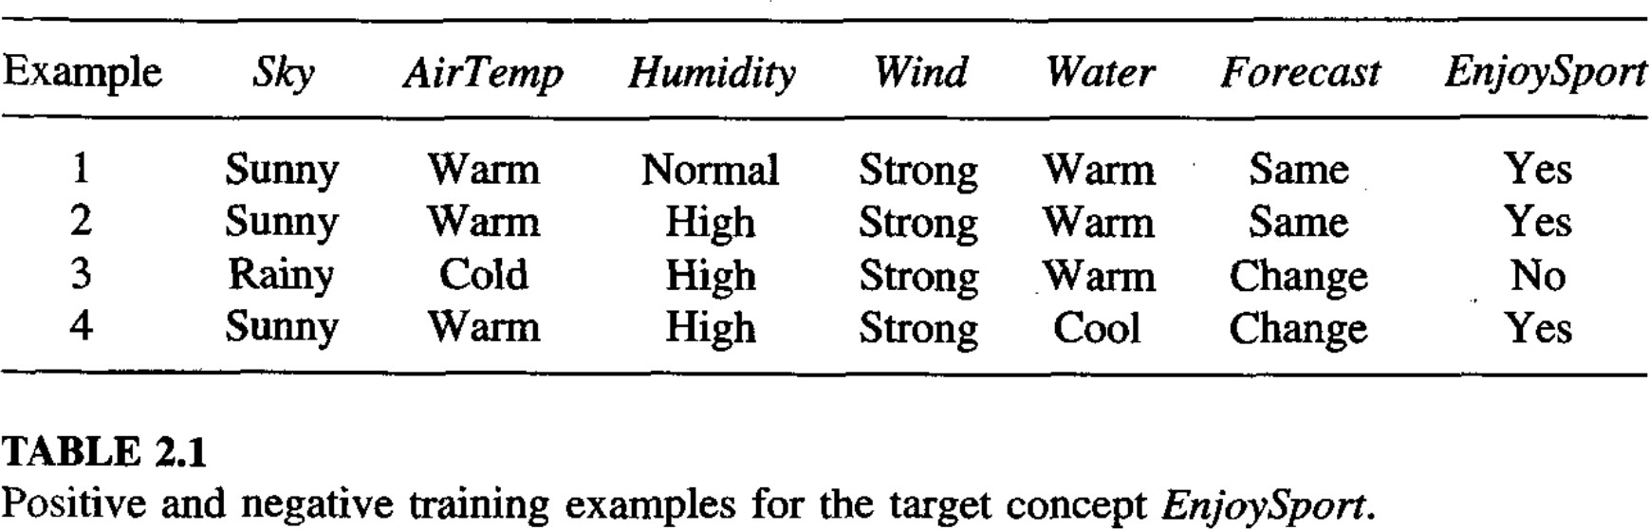

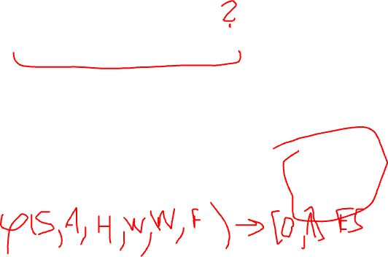
EnjoySport Example
Sky: Sunny, Cloudy, Rainy AirTemp: Warm, Cold Humidity: Normal, High
Wind: Strong, Weak Water: Warm, Cold Forecast: Same, Change
What do you think the decision function is?
What is the size of the instance space?
How many possible decision functions are there?
10

Slide 25
Hypothesis Representation
h(x) = 1 if EnjoySport is Yes and 0 otherwise
How should we represent h(.)?
Let’s start with a simple one
A conjunction (and) of constraints on the attributes
<Sky, AirTemp, Humidity, Wind, Water, Forecast>
? indicates any value is acceptable
A specific value means it must be that value
ϕ means no value is acceptable
For example <Sunny, ?, ?, Strong, ?, ?> means
Sky must be Sunny, Wind must be Strong, and other
attributes can be any value
c(x) is the true function that is not given, except on training data
11

Slide 26
Propositional Logic Review
12

Slide 27
Propositional Logic Language
Propositional symbols
P, Q, R, …
True, False
Connectives
¬, ∧, ∨, ⇒, ⇐, ⇔
13

Slide 28
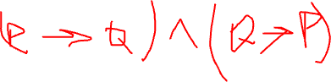
More on the Connectives
¬ (negation)
∧ (and): P ∧ Q is called a conjunction and P and Q are conjuncts
∨ (or): P ∨ Q is called a disjunction and P and Q are disjuncts
⇒ (implies): P ⇒ Q is called an implication. P is the premise or antecedent and Q is its conclusion or consequent
⇔ (if and only if): P ⇔ Q is called a
biconditional
14

Slide 29
Syntax
Sentence → AtomicSentence | ComplexSentence
AtomicSentence → True | False | P | Q | R | …
ComplexSentence →
¬ sentence
sentence ∧ sentence
sentence ∨ sentence
sentence ⇒ sentence
sentence ⇔ sentence
Operator precedence: ¬, ∧, ∨, ⇒, ⇔
15

Slide 30
Semantics
Semantics define the rules for determining the truth of a sentence with respect to a model
A model fixes the truth value of for every proposition
In other words, a model assigns a value (True or False) to every predicate in propositional logic
16

Slide 31
Semantics of Propositional Logic
It specifies how to determine the truth value of any sentence in a model m
The truth value of True is True
The truth value of False is False
The truth value of each atomic sentence is given by m
The truth value of every other sentence is obtained recursively by using truth tables
17

Slide 32
Truth Rules
¬ P is true iff P is false
P∧Q is true iff both P and Q are true
P∨Q is true iff either P or Q or both are true
P⇒Q is true unless P is true and Q is false
P⇔Q is true iff P and Q have equal truth values; i.e., iff both P and Q are true or iff both P and Q are false
18

Slide 33

Truth Tables
P | Q | ¬P | P∧Q | P∨Q | P⇒Q | P⇔Q
T | T | F | T | T | T | T
T | F | F | F | T | F | F
F | T | T | F | T | T | F
F | F | T | F | F | T | T
19

Slide 34
Back to Concept Learning
21

Slide 35
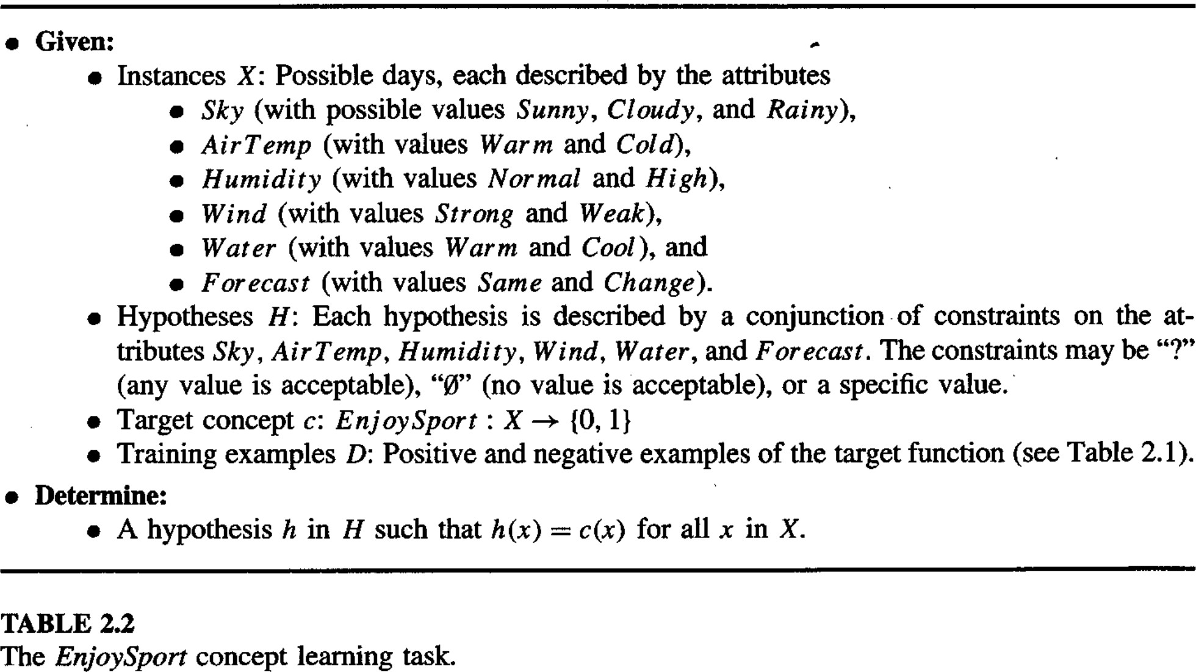
EnjoySport Problem Formulation
22

Slide 36
True Concept
Let the true concept be c(x)
We do not know what c(x) is
All we have is a training dataset D that consists
of <x, c(x)> pairs
We define a hypothesis space H, for which we hope c∈H, and we search for h∈H such that
h(x) = c(x) ∀x∈D
23

Slide 37
Most-general and Most-specific
Most-general hypothesis, i.e., the hypothesis where h(x) = 1 ∀x∈X
<?, ?, ?, ?, ?, ?>
Most-specific hypothesis, i.e., the hypothesis where h(x) = 0 ∀x∈X
<ϕ, ϕ, ϕ, ϕ, ϕ, ϕ>
Note that in this formulation, h(x) = 0 ∀x∈X when at least one entry is ϕ. For example, h(x) = 0 ∀x∈X when h = <?, ?, ϕ, ?, ?, ?>.
24

Slide 38
‘More-General’ Relation
Let h_{j} and h_{k} be Boolean-valued functions defined over X. Then h_{j} is more general than or equal to h_{k} (written has h_{j} ≥ h_{k}) if and only if
∀𝑥 ∈ 𝑋 ℎ_{𝑘} 𝑥 = 1 ⇒ ℎ_{𝑗} 𝑥 = 1
That is, whenever h_{k} says positive, h_{j} also says positive; h_{j} might say positive to other instances that h_{k} says negative
25

Slide 39
The Instance and Hypothesis Space
Six attributes:
Sky has three possible values, others have two possible values
Total number of possible instances
3 × 2 × 2 × 2 × 2 × 2 = 96
One hypothesis
Each attribute is ?, ϕ, or a specific value
Total number of syntactically-different hypotheses
5 × 4 × 4 × 4 × 4 × 4 = 5120
Any hypothesis that contains at least one ϕ has the same meaning; i.e., it classifies all instances as negative
Total number of semantically-different hypotheses
4 × 3 × 3 × 3 × 3 × 3 + 1 = 973
How do we search this space efficiently?
26

Slide 40
Algorithms
Find-S
List-Then-Eliminate
Candidate-Elimination
28

Slide 41
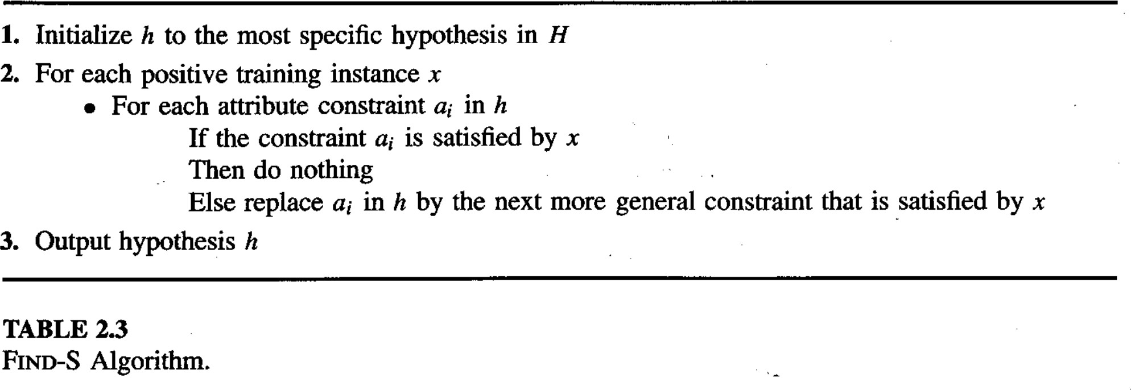
Find-S
29

Slide 42
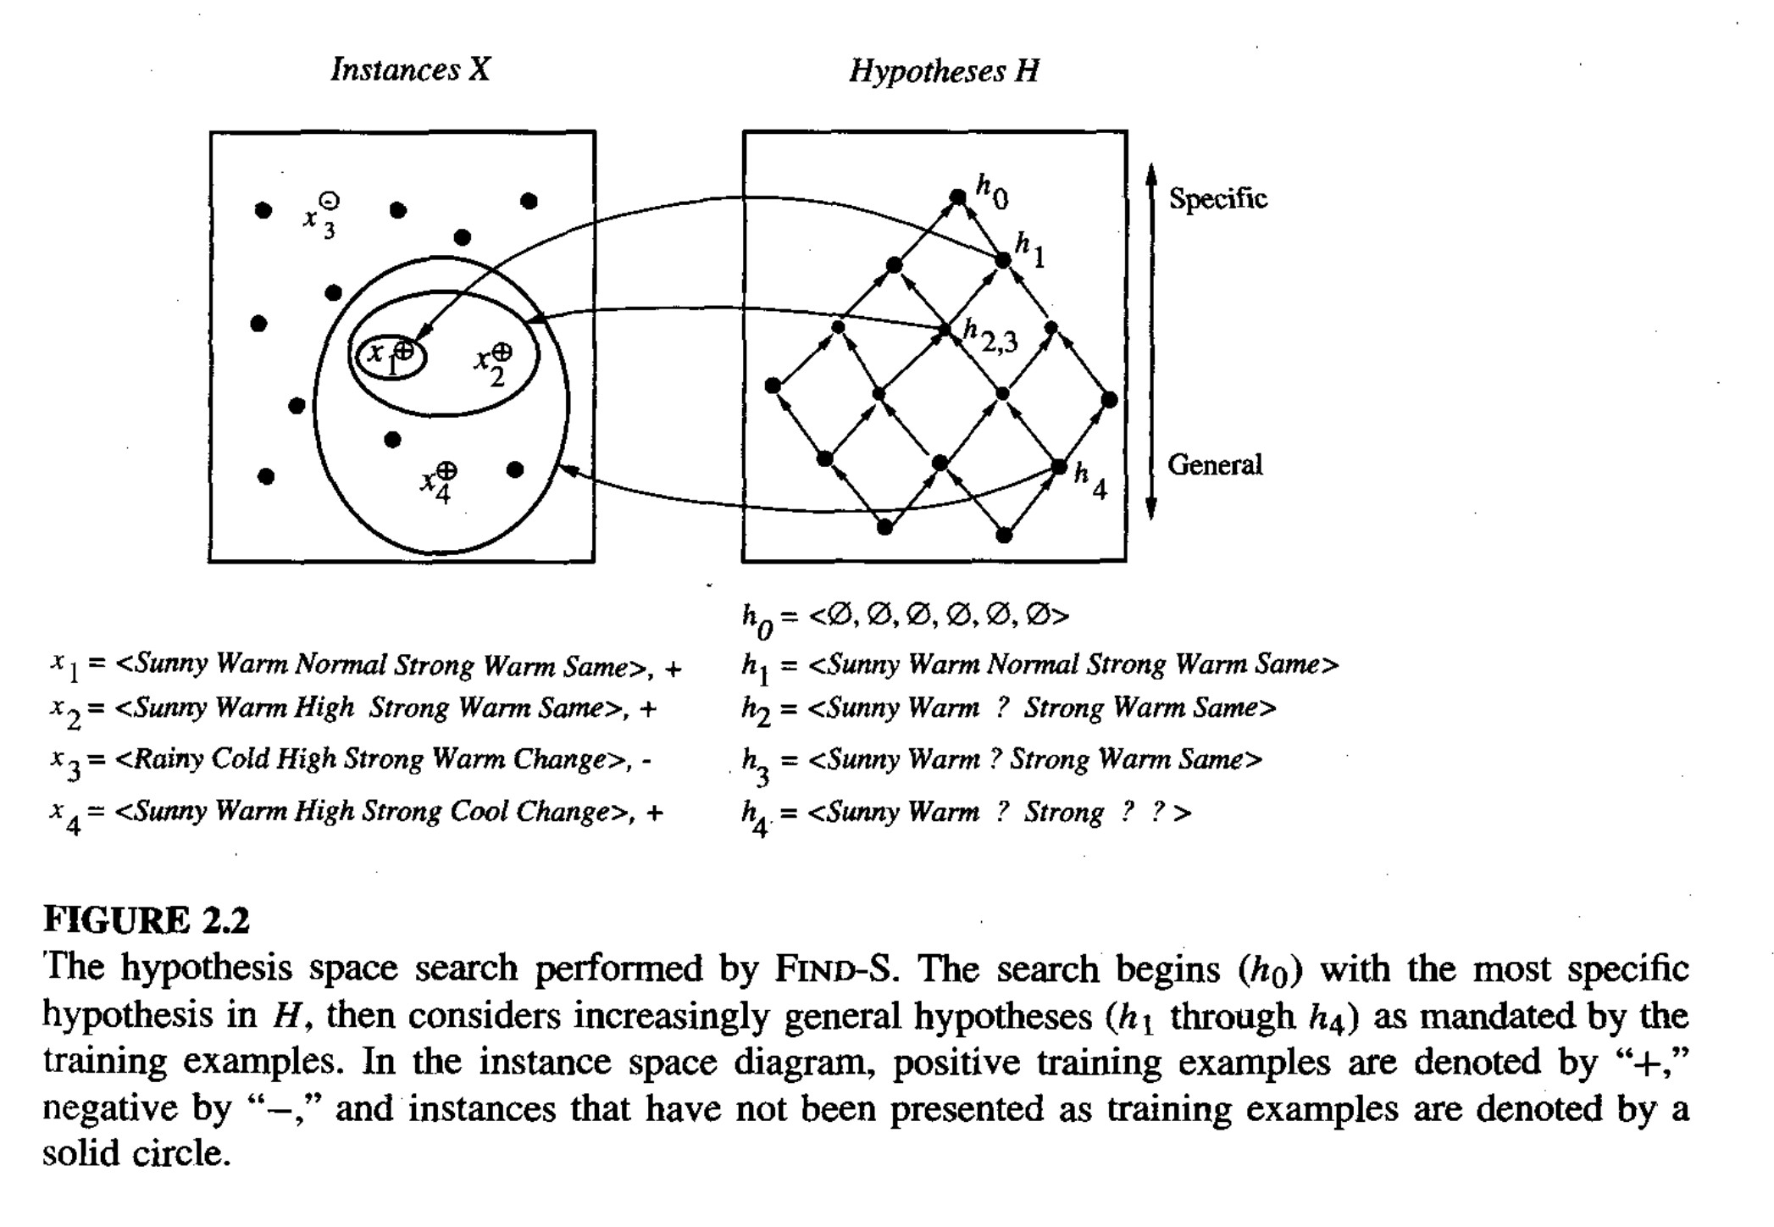
Find-S Trace
Credit: Tom Mitchell, Machine Learning
30

Slide 43
Problems with Find-S
How do we know the h(.) returned by Find-S is the actual c(.)?
If there are more than one hypotheses that are consistent with data, Find-S finds only the most specific one. Why settle for the most specific one? For example, why not the most general one?
What happens when the training data has errors?
What if the most-specific hypothesis is not unique?
31

Slide 44
Version Space
A hypothesis h() is consistent with a set of training examples D and a target concept c() if and only if h() agrees with c() on each training example in D
𝐶𝑜𝑛𝑠𝑖𝑠𝑡𝑒𝑛𝑡 ℎ, 𝐷 ≡ ∀ 𝑥, 𝑐 𝑥 ∈ 𝐷 ℎ 𝑥 = 𝑐 𝑥
Version space with respect to hypothesis space H and dataset D is the set of all hypotheses in H that are consistent with all examples in D
𝑉𝑆_{𝐻,𝐷} ≡ ℎ ∈ 𝐻|𝐶𝑜𝑛𝑠𝑖𝑠𝑡𝑒𝑛𝑡(ℎ, 𝐷)
32

Slide 45
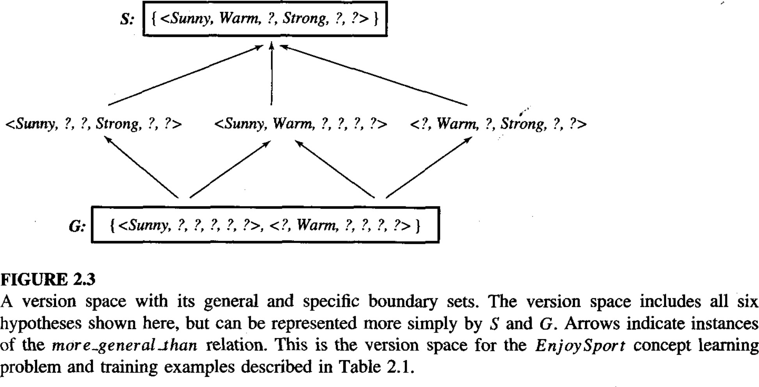
Version Space
33

Slide 46
List-Then-Eliminate
𝑉𝑆 ← a list of containing every hypothesis in H
For each training example, 𝑥, 𝑐(𝑥)
Remove from 𝑉𝑆 any hypothesis h for which h(x) ≠ c(x)
Output 𝑉𝑆
Advantages
Outputs all consistent hypotheses
Disadvantages
Need to list all possible hypotheses
Impossible for infinite hypothesis spaces
Impractical for large hypothesis spaces
34

Slide 47
Candidate-Elimination
General boundary G: the set of maximally-general consistent hypotheses.
_{𝑔}′
𝐺 ≡ 𝑔 ∈ 𝐻 𝐶𝑜𝑛𝑠𝑖𝑠𝑡𝑒𝑛𝑡(𝑔, 𝐷) ∧ ¬∃𝑔′ ∈ 𝐻 > 𝑔 ∧ 𝐶𝑜𝑛𝑠𝑖𝑠𝑡𝑒𝑛𝑡(𝑔′, 𝐷)
Specific boundary S: the set of maximally-specific
consistent hypotheses.
S ≡ 𝑠 ∈ 𝐻 𝐶𝑜𝑛𝑠𝑖𝑠𝑡𝑒𝑛𝑡(𝑠, 𝐷) ∧ ¬∃𝑠′ ∈ 𝐻 𝑠 > 𝑠′ ∧ 𝐶𝑜𝑛𝑠𝑖𝑠𝑡𝑒𝑛𝑡(𝑠′, 𝐷)
Version space representation theorem: for every consistent hypothesis there is at least one more-general-or- equal-to hypothesis in G and there is at least one more- specific-or-equal-to hypothesis in S
𝑉𝑆_{𝐻,𝐷} = ℎ ∈ 𝐻 ∃𝑠 ∈ 𝑆 ∃𝑔 ∈ 𝐺 𝑔 ≥ ℎ ≥ 𝑠
Candidate elimination algorithm
Start with S that has only the most-specific hypothesis and G that has only the most-general hypothesis, and modify S and G with each training data
35

Slide 48
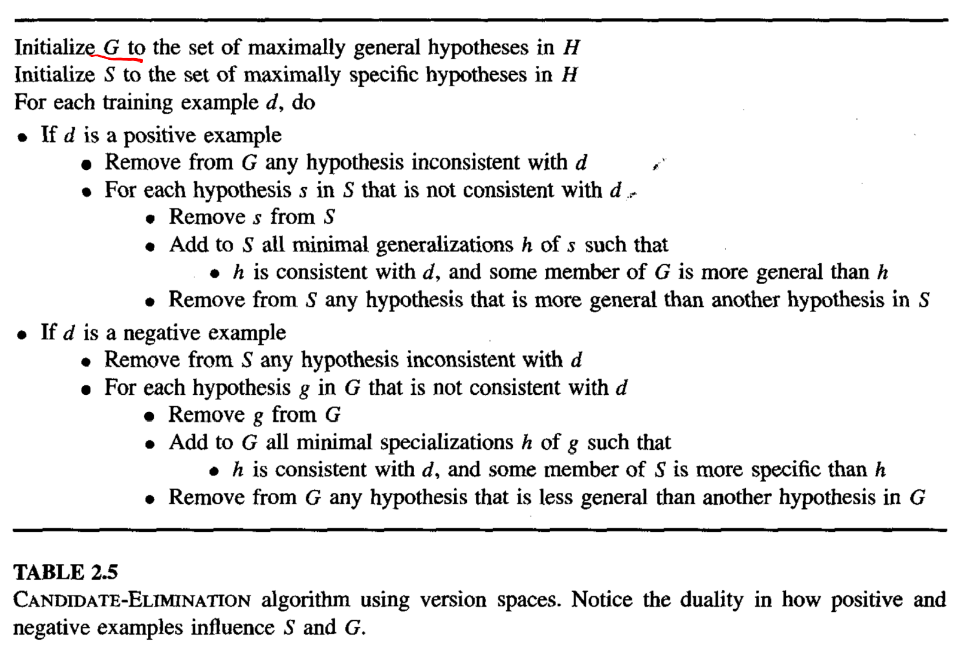




Candidate Elimination Algorithm
36

Slide 49
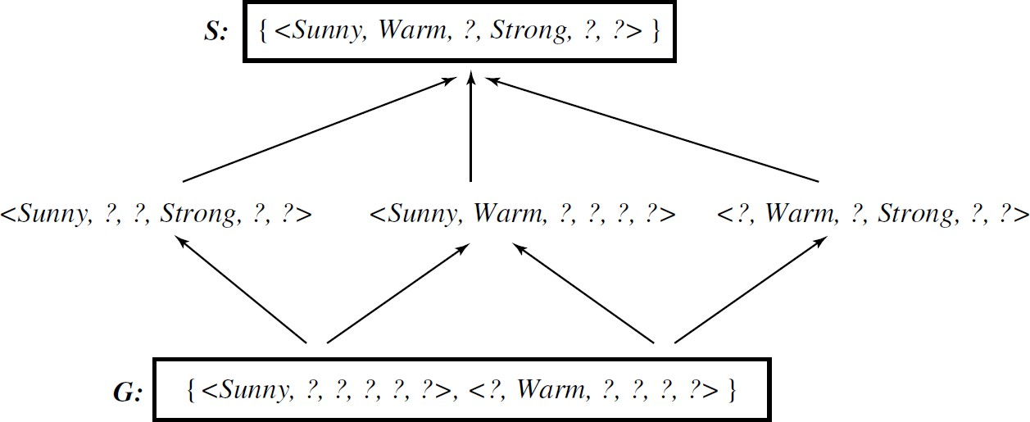
Solution
38

Slide 50
Correct Hypothesis?
If the training data does not contain errors, and, if the correct hypothesis is in H, then the candidate elimination algorithm will converge toward the correct hypothesis with each new training example
If the training data contains errors, for example, let’s say a positive example is annotated incorrectly as negative, then the correct hypothesis will surely be removed from the solution. Given enough data S and G might eventually become empty
If the correct hypothesis is not in H, for example, if the correct hypothesis contains disjunctions whereas H contains only conjunctive hypotheses, given enough data, S and G might eventually become empty
39

Slide 51
Given S and G, how do we classify a new example?
If the version space contain only one hypothesis, then classification of a new example is straightforward
What if the version space contains multiple hypotheses, like the one that we just saw?
41

Slide 52
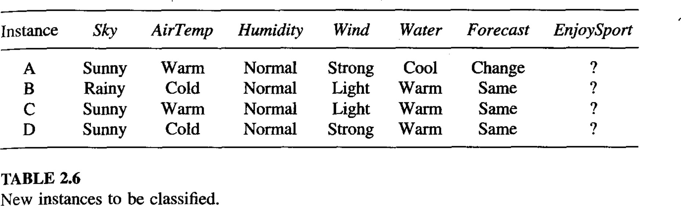















Classify the following
42

Slide 53
Active Learning
Given the following version space, and if we give the algorithm the choice to choose the next example and ask for its label, what example should it ask about?
43

Slide 54
Inductive Bias
We assumed that H is the conjunction of attributes. This is our inductive bias.
What happens when the target concept is not in H?
Can we avoid these problems by having a hypothesis space that has all possible hypotheses? That is, what if our hypothesis space is unbiased?
First, how big is such a hypothesis space?
Given n Boolean attributes, there are 2^{𝑛} possible examples
Each example can be a positive or negative example
Therefore, there are 2^{2𝑛} possible hypotheses!
Second, how useful are such hypotheses?
44

Slide 55
Biased vs Unbiased Learning
In biased learning, we make assumptions about the hypothesis space
In unbiased learning, no assumptions are made
about the hypothesis space
Purpose of concept learning: generalize to unseen data
Unbiased learning simply memorizes the training data and it has no hope of generalizing to unseen data
46

Slide 56
Another Example
47

Slide 57
Is the Coffee Good?
You grind and brew your own coffee at home
You can control grind size, the amount of coffee, the water temperature, brewing time, etc.
For simplicity, let’s look at only the coffee amount and
the water temperature
Too little or too much coffee is not good
Too cold or too hot water is not good
What’s best depends on the person
You experiment with different coffee amounts and water temperatures and record your experience as positive or negative
48

Slide 58
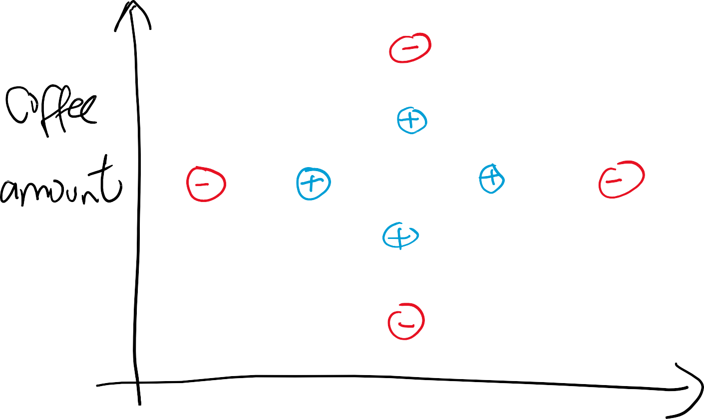






Experiment
49

Slide 59
Experiment
Assume the hypothesis space is the space of rectangles
That is,
ℎ 𝑎, 𝑡 = 𝑝𝑜𝑠𝑖𝑡𝑖𝑣𝑒 if 𝑎₁ ≤ 𝑎 ≤ 𝑎₂ and 𝑡₁ ≤ 𝑡 ≤ 𝑡₂
What are S, G, and version space based on the training data?
50

Slide 60
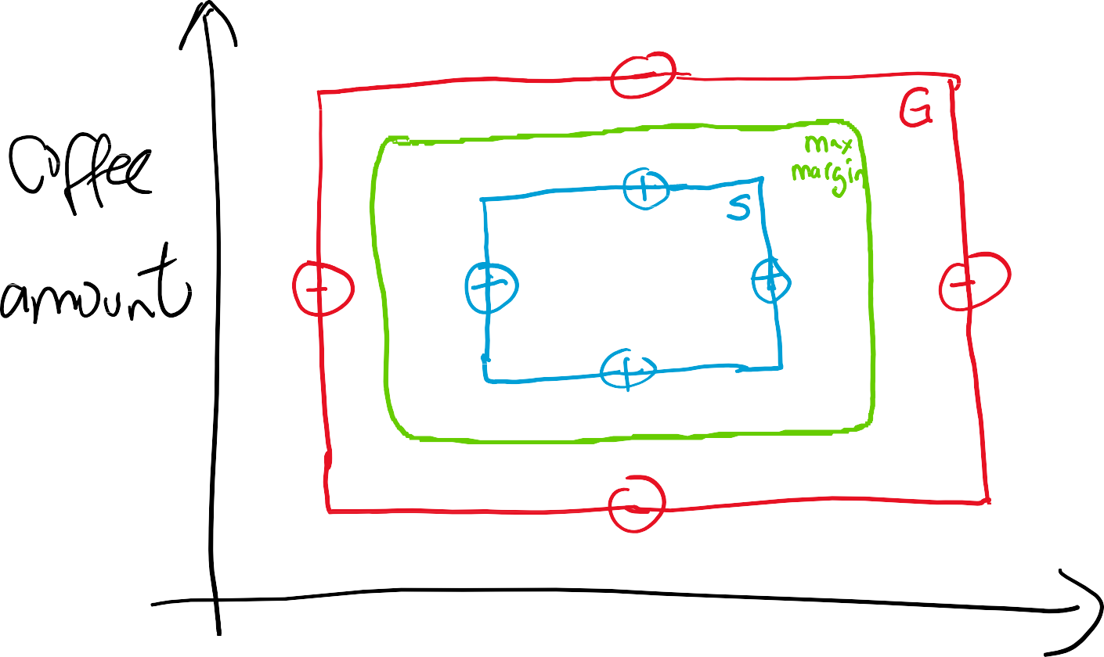
S, G, Version Space, Max Margin
51

